Slide 1


Ionic T01 Intro

Slide 2
OVERVIEW
TO IONIC FRAMEWORK

Slide 3

What is Ionic?
Ionic Framework is an open source UI toolkit for building performant, high-quality mobile and desktop apps using web technologies (HTML, CSS, and JavaScript).

Slide 4
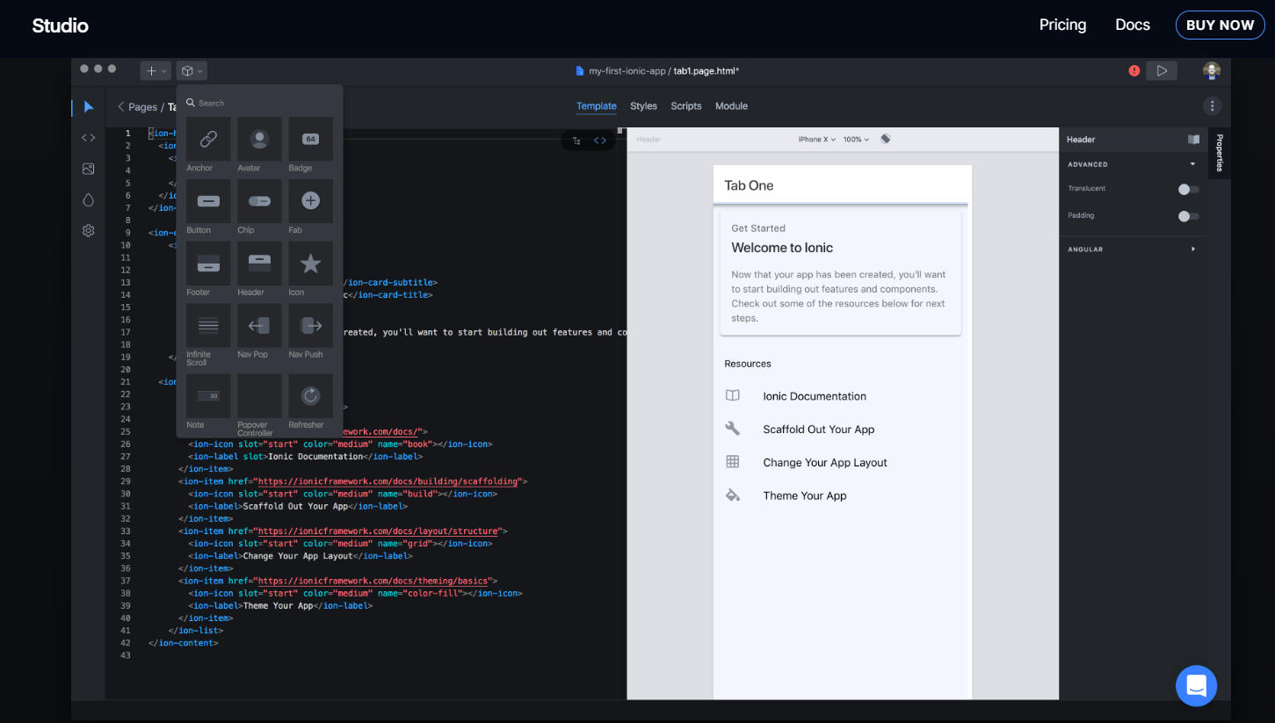
Ionic Studio

Slide 5
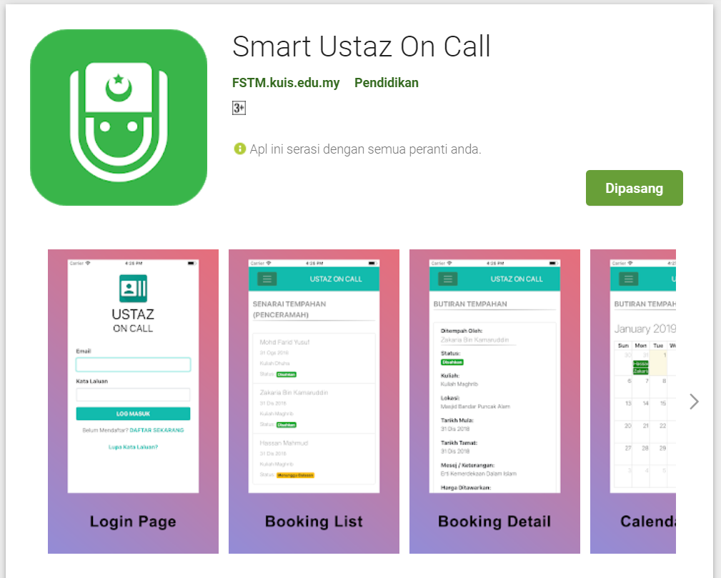
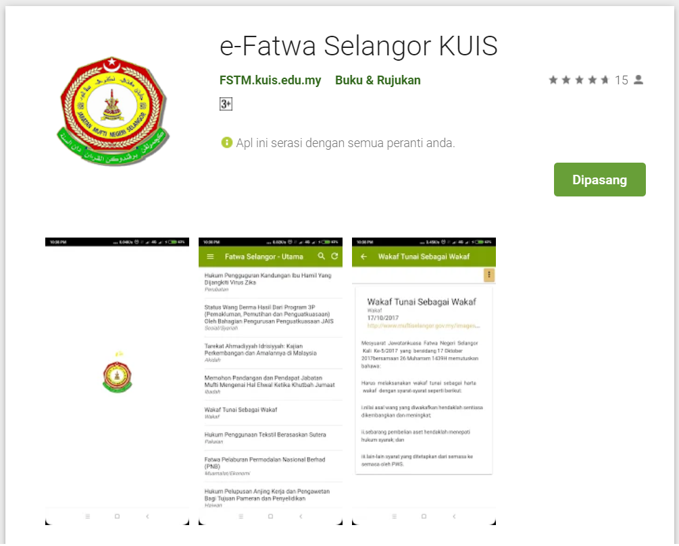
Available apps

Slide 6
IOS & Android Software Development
In a nutshell

Slide 7





Android Studio
(Java & Kotlin)
Android Device
NATIVE - 2 X WORK
XCode (Swift & Objective C)
iPhone/iPad

Slide 8

1 x WORK
Compile with Android SDK
Android Device
Cordova
Framework
Hybrid
XCode Project
iPhone/iPad

Slide 9
Cordova
Framework
Hybrid
WEB LAYER
NATIVE APP

Slide 10
1 x WORK
Build Progressive Web Apps
Android Device
Build Progressive Web Apps
Cordova
Framework
Hybrid
iPhone/iPad

Slide 11


1 x WORK
Android Studio
Android Device
+
XCode
iPhone/iPad

Slide 12
https://capacitor.ionicframework.com/

Slide 13



WHY IONIC?
Framework specifically to develop apps
Multiple platforms-Android, IOS, Windows, Amazon etc
Apps development using HTML & Typescript (subset of Javascript)
Plugins (camera, thumbprint, bluetooth, printer etc etc etc)

Slide 14
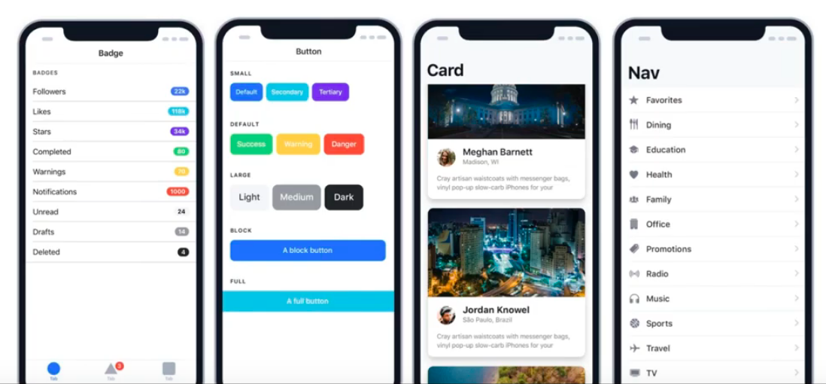
WHY IONIC?
Large COMMUNITY for support
Pre built gestures & animation
100+ UI Components
Everything is OPEN SOURCE
Built with Ionic

Slide 15
Software to start Ionic?

Slide 16
What do you need?
To run IONIC:
Node Package Manager (NPM)
Ionic Cordova Framework
Google Chrome Web Browser
To develop/publish app
VSCode OR any other IDE (with Typescript Plugin)
Ionic Capacitor
Android SDK or Xcode - can be done later

Slide 17
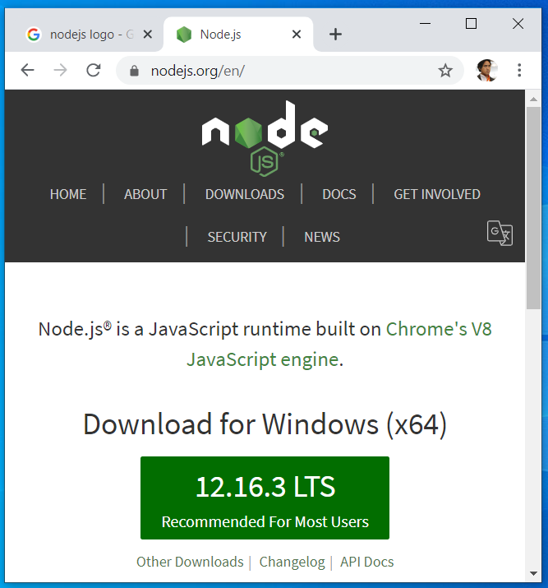

Download from nodejs.org
Download and install the LTS version
http://nodejs.org

Slide 18
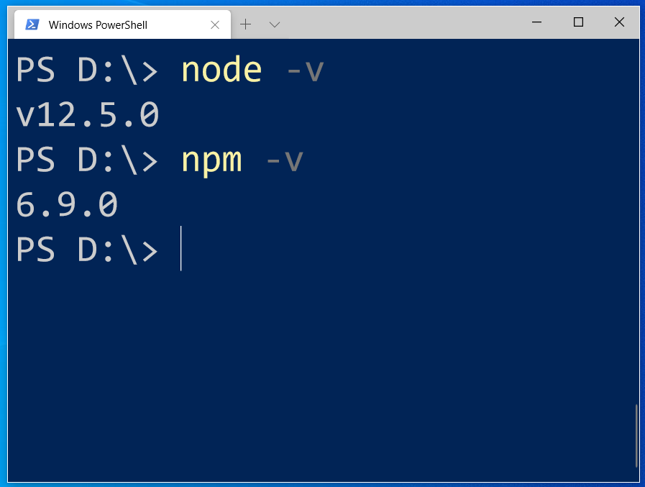
After install NodeJS from nodejs.org
node -v
npm -v

Slide 19
2. From command terminal run:
npm install -g ionic cordova

Slide 20
Now, let’s install the tools

Slide 21
Install VSCode/sublime
NodeJS
Tutorial is here bit.ly/ionickerul
Install Google Chrome Browser
(If you don’t have, you should)

Slide 22
Before we start coding, some basic stuff...

Slide 23
-HTML?
-CSS ?
-TypeScript ?

Slide 24
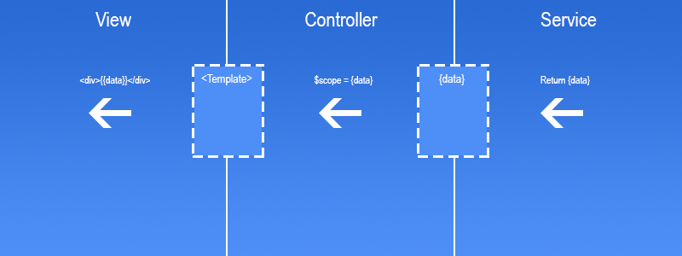
Simple MVC in Ionic
.HTML | .TS | services .TS /Model

Slide 25
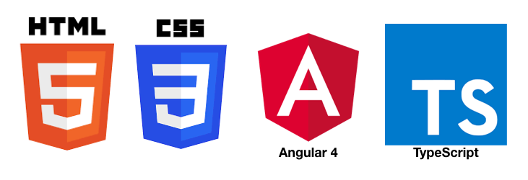
HTML
-Hyper Text Mark Up Language (HTML)
-Used to display the interface
-Write in tags,
-Example- <strong>Hello</strong> → Hello
-Ionic has its own built in tags
<ion-list></ion-list>
<ion-item></ion-item>
<ion-grid></ion-grid>
-HTML in Ionic is “AngularJS Flavoured”
-Have to use Angular Syntax for data and clicks
-Example- (click), *ngFor etc

Slide 26
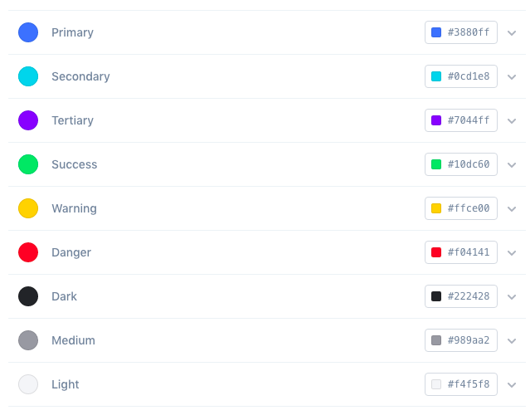
CSS or SCSS
-Cascading Style Sheets (CSS)
-Used for styling, very straightforward
-Each generated Ionic page comes with built in own CSS
-Can assist in ‘theming’ the app
-Ionic has standard built in colours
-Primary, Secondary, Danger, Light & Dark
Built in colours that can be added/edited

Slide 27
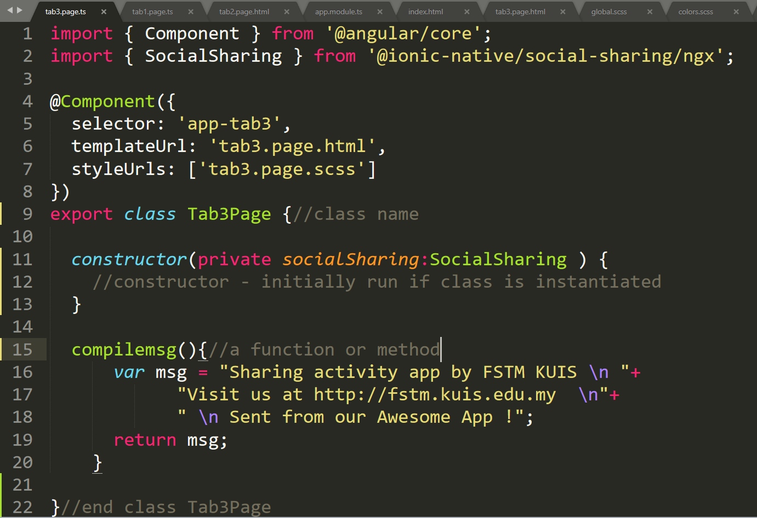
Class Function

Slide 28
Hello World ionic

Slide 29
1. Start a project
ionic start appfstm tabs

Slide 30
2. CD into Directory & Run the project
ionic serve

Slide 31
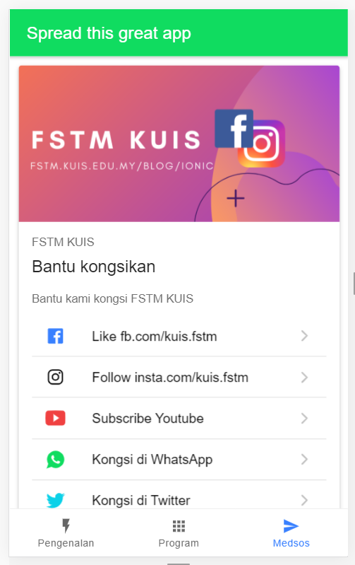
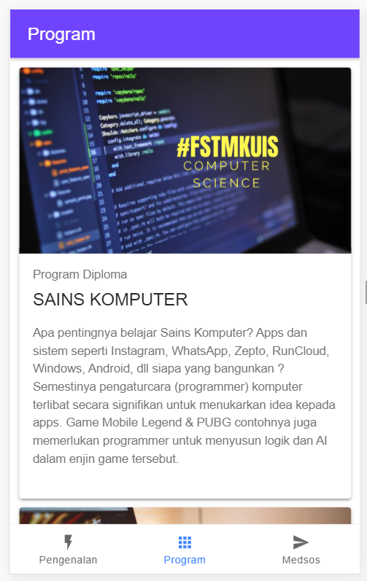
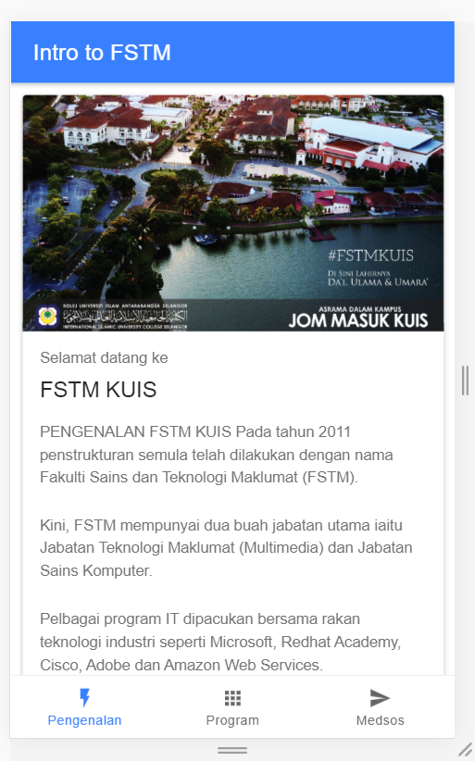
Next tab2 and tab3

Slide 32


T02 HTML interface
(antaramuka)

Slide 33
1. Start a project
ionic start appfstm tabs

Slide 34
2. CD into Directory & Run the project
ionic serve

Slide 35
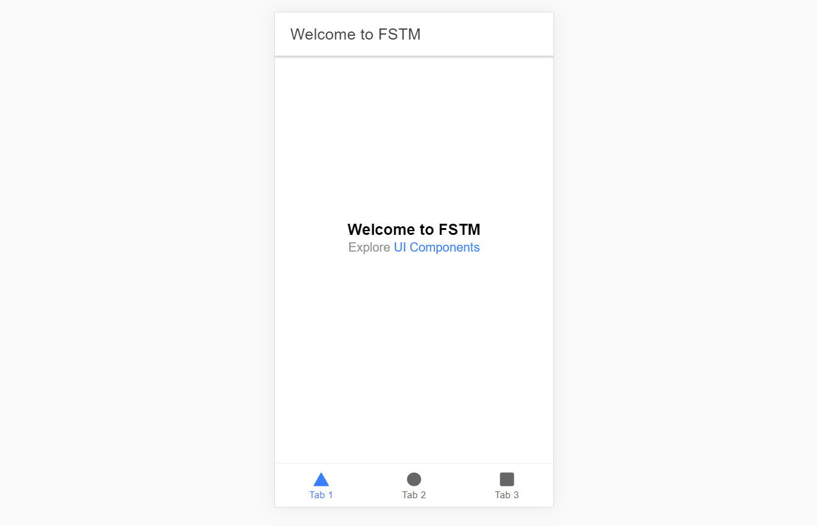
Output : ionic serve

Slide 36
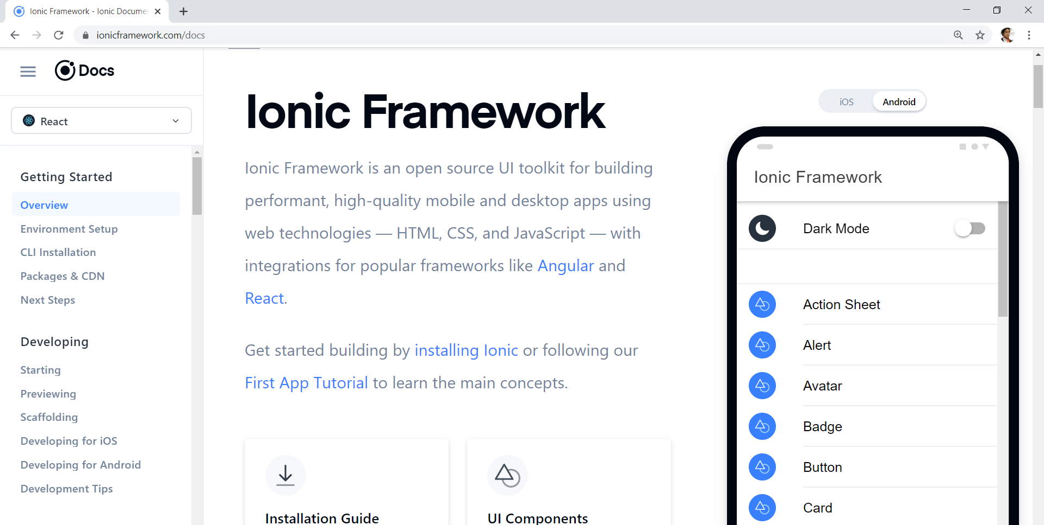
Always refer to documentations: https://ionicframework.com/docs

Slide 37
HTML
-Hyper Text Mark Up Language (HTML)
-Used to display the interface
-Write in tags,
-Example- <strong>Hello</strong> → Hello
-Ionic has its own built in tags
<ion-list></ion-list>
<ion-item></ion-item>
<ion-grid></ion-grid>
-HTML in Ionic is “AngularJS Flavoured”
-Have to use Angular Syntax for data and clicks
-Example- (click), *ngFor etc

Slide 38
CSS or SCSS
-Cascading Style Sheets (CSS)
-Used for styling, very straightforward
-Each generated Ionic page comes with built in own CSS
-Can assist in ‘theming’ the app
-Ionic has standard built in colours
-Primary, Secondary, Danger, Light & Dark
Built in colours that can be added/edited

Slide 39
Next tab2 and tab3

Slide 40
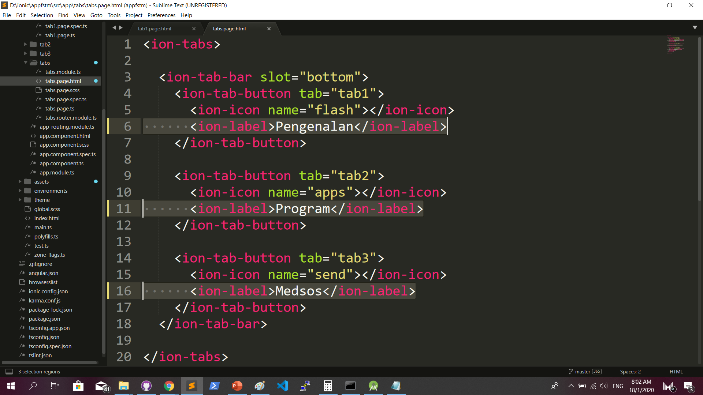
Some interface cosmetics: src/app/tabs/tabs.page.html

Slide 41
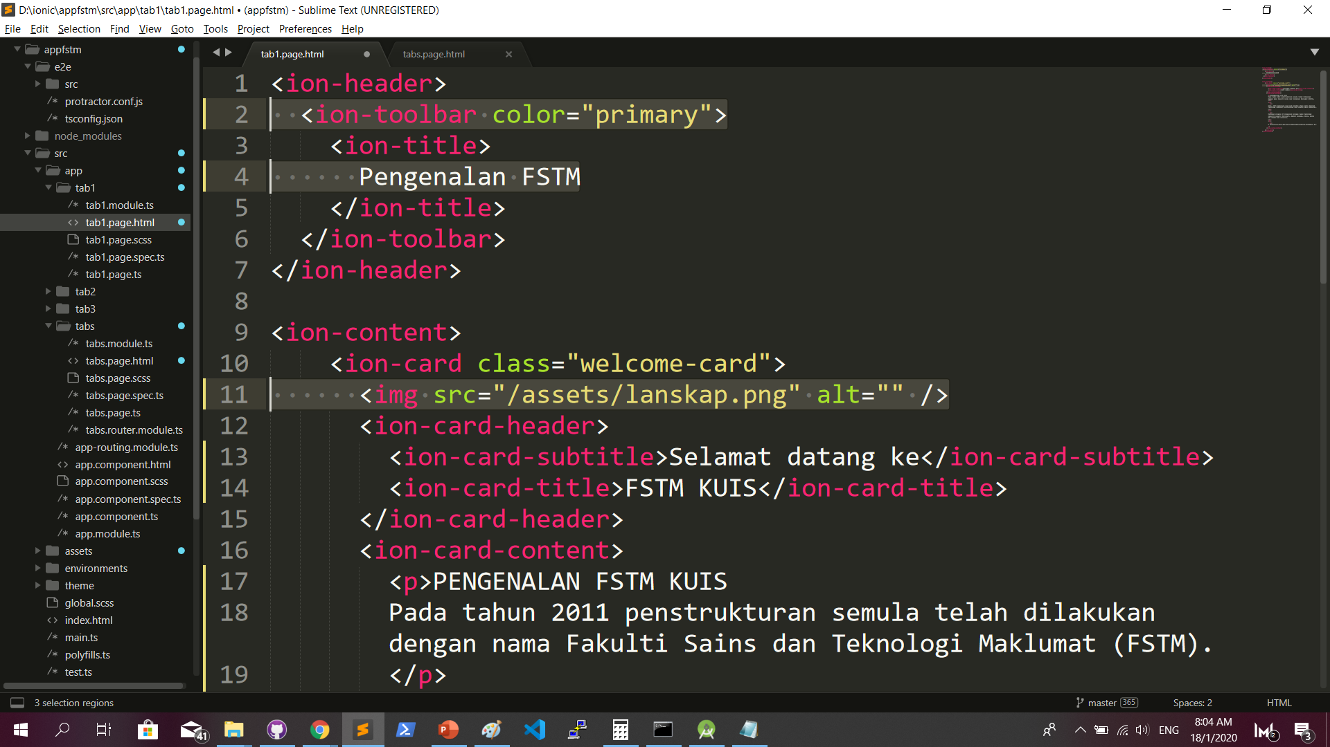
More interface cosmetics: src/app/tab1/tab1.page.html

Slide 42
Run ionic serve

Slide 43
Next tab2 and tab3

Slide 44
Codes & slides github.com/khirulnizam/ionic5

Slide 45
T03 Navigasi
(page navigation)

Slide 46
Page Navigation
+ routerLink (in .html) + NavController (in .ts)

Slide 47
routerLink in HTML
PAGE 1
PAGE 2
See app-routing.module.ts for page name

Slide 48
Exercise : Link to new page
Generate new pages
ionic g page info
ionic g page form

Slide 49
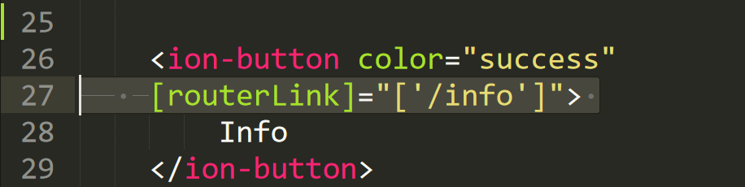
Exercise : Link to new page

Slide 50
NavController in TS
PAGE 1
PAGE 2
See app-routing.module.ts for page name

Slide 51
Add simple form interaction
+ Form Button + Alert function

Slide 52
Try building a button and make an alert
helloWorld(){
alert(“Hello Ionic!”)
}
<ion-button (click)=”helloWorld()”> ALERT </ion-button>
info.page.ts
info.page.html

Slide 53

Codes & slides github.com/khirulnizam/ionic5

Slide 54

T04 TypeScript

Slide 55
TypeScript
-A subset of Javascript
-Part of ECMA6 standard
-The ‘brains’ behind your app
-Used for processing & handling data
Example- calculation, accessing DB etc
-Ionic has standard built in to its TS:
NavController, ModalController etc

Slide 56
Typescript Syntax : Function
n1:number;
n2:number;
output:any;
addnumbers(){
output=n1+n2;
displayresult( );
}
displayresult( ){
alert(“Output: ”+output);
}

Slide 57
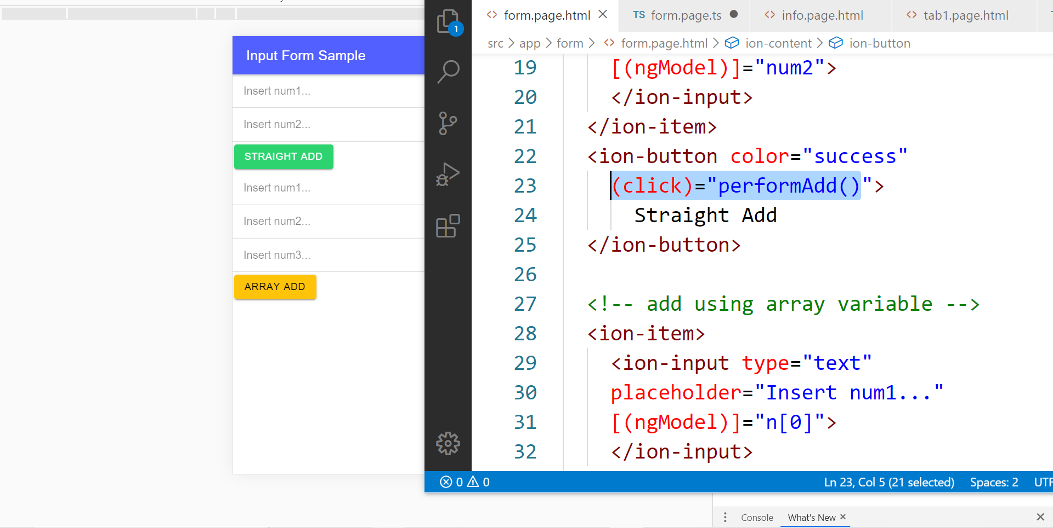
In file .HTML

Slide 58
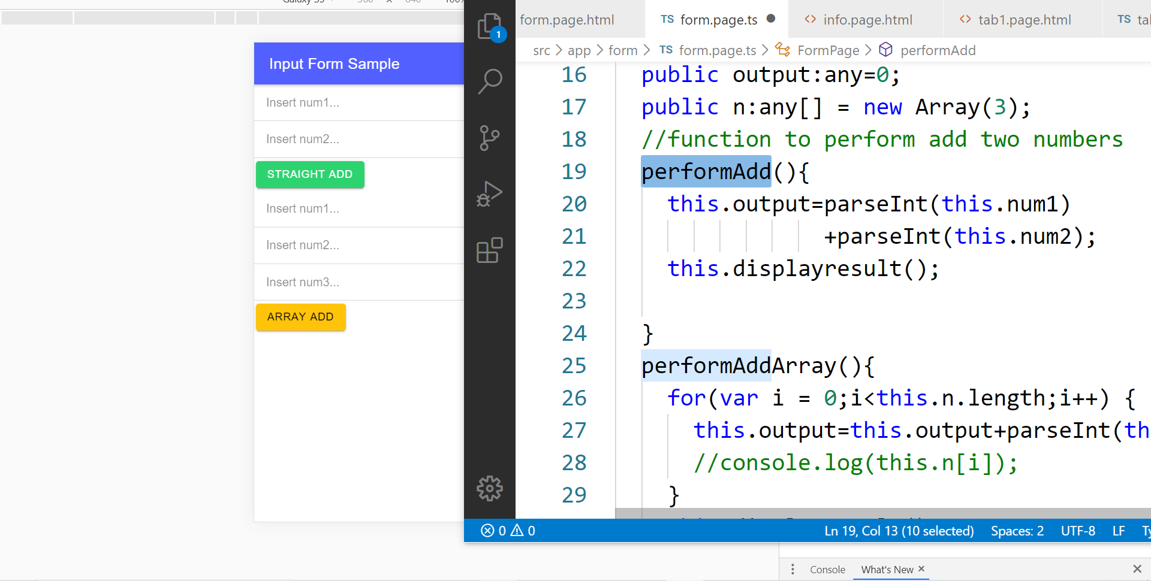
In file .TS

Slide 59
TypeScript Syntax : EX1 variable
What is a variable?
A variable acts as a container for values in a programming code.
var pi:number = 3.14;
Var num1:number=5;
var name:string =“enKerul”;
Use any to loosely-type the variable data type.
Data types:
any
can be numbers or strings
string
“this is string ” + “ concat ”
number
Double 3.14, or integer 5
array
can be a collection of Var, Strings or Objects

Slide 60
Typescript Syntax : EX2 String manipulation & Casting
//to convert String to number
var str = "54";
//easy way by using + operator
var num = +str; var num = parseInt(str);
String manipulation?
var str:string = "3.14";
var pi:number = 3.14;
console.log("pi is "+pi);
console.log("tau is "+(2 * pi));

Slide 61
Typescript Syntax : EX3 Array
Array? Array
can be a collection of Var, Strings or Objects
// A list literal.
var numbers = [4, 1, 5, 6, 3, 2];
for(var i=0;i<numbers.length; i++)
{
sum=sum+numbers[i]);
console.log(“Sum: ”+sum);
}
-----
Output
Sum: 21

Slide 62
Typescript Syntax : EX4 Associative array
Associative Array?
Array with key and value pairs (not index number).
// A map literal.
// Asociative array
var gases = [
'He': 'Helium',
'Ne': 'Neon',
'Ar': 'Argon’,
];
console.log(gases['Ne’]);
-------------------------
Output: Neon

Slide 63


T05 Kamera (installing camera plug-ins)

Slide 64
Codes & slides github.com/khirulnizam/ionic5

Slide 65
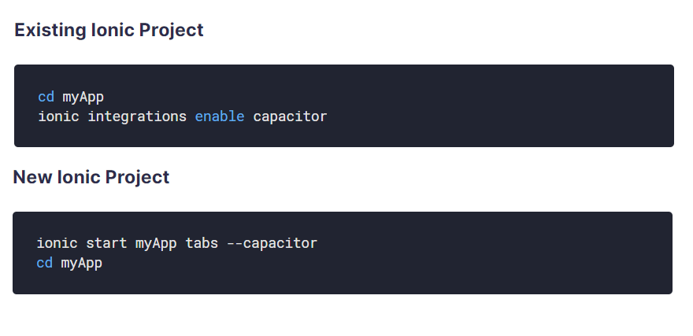
Using Capacitor with Ionic

Slide 66
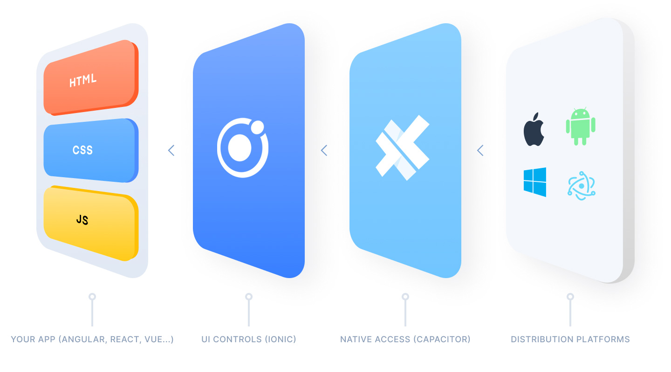
Ionic Capacitor
https://ionicframework.com/resources/articles/capacitor-vs-cordova-modern-hybrid-app-development
runs modern Web Apps natively on iOS, Android, Electron, and Web

Slide 67
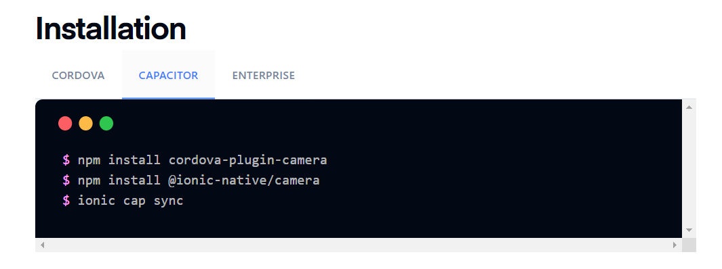
Install camera support : ionicframework.com/docs/native/camera

Slide 68
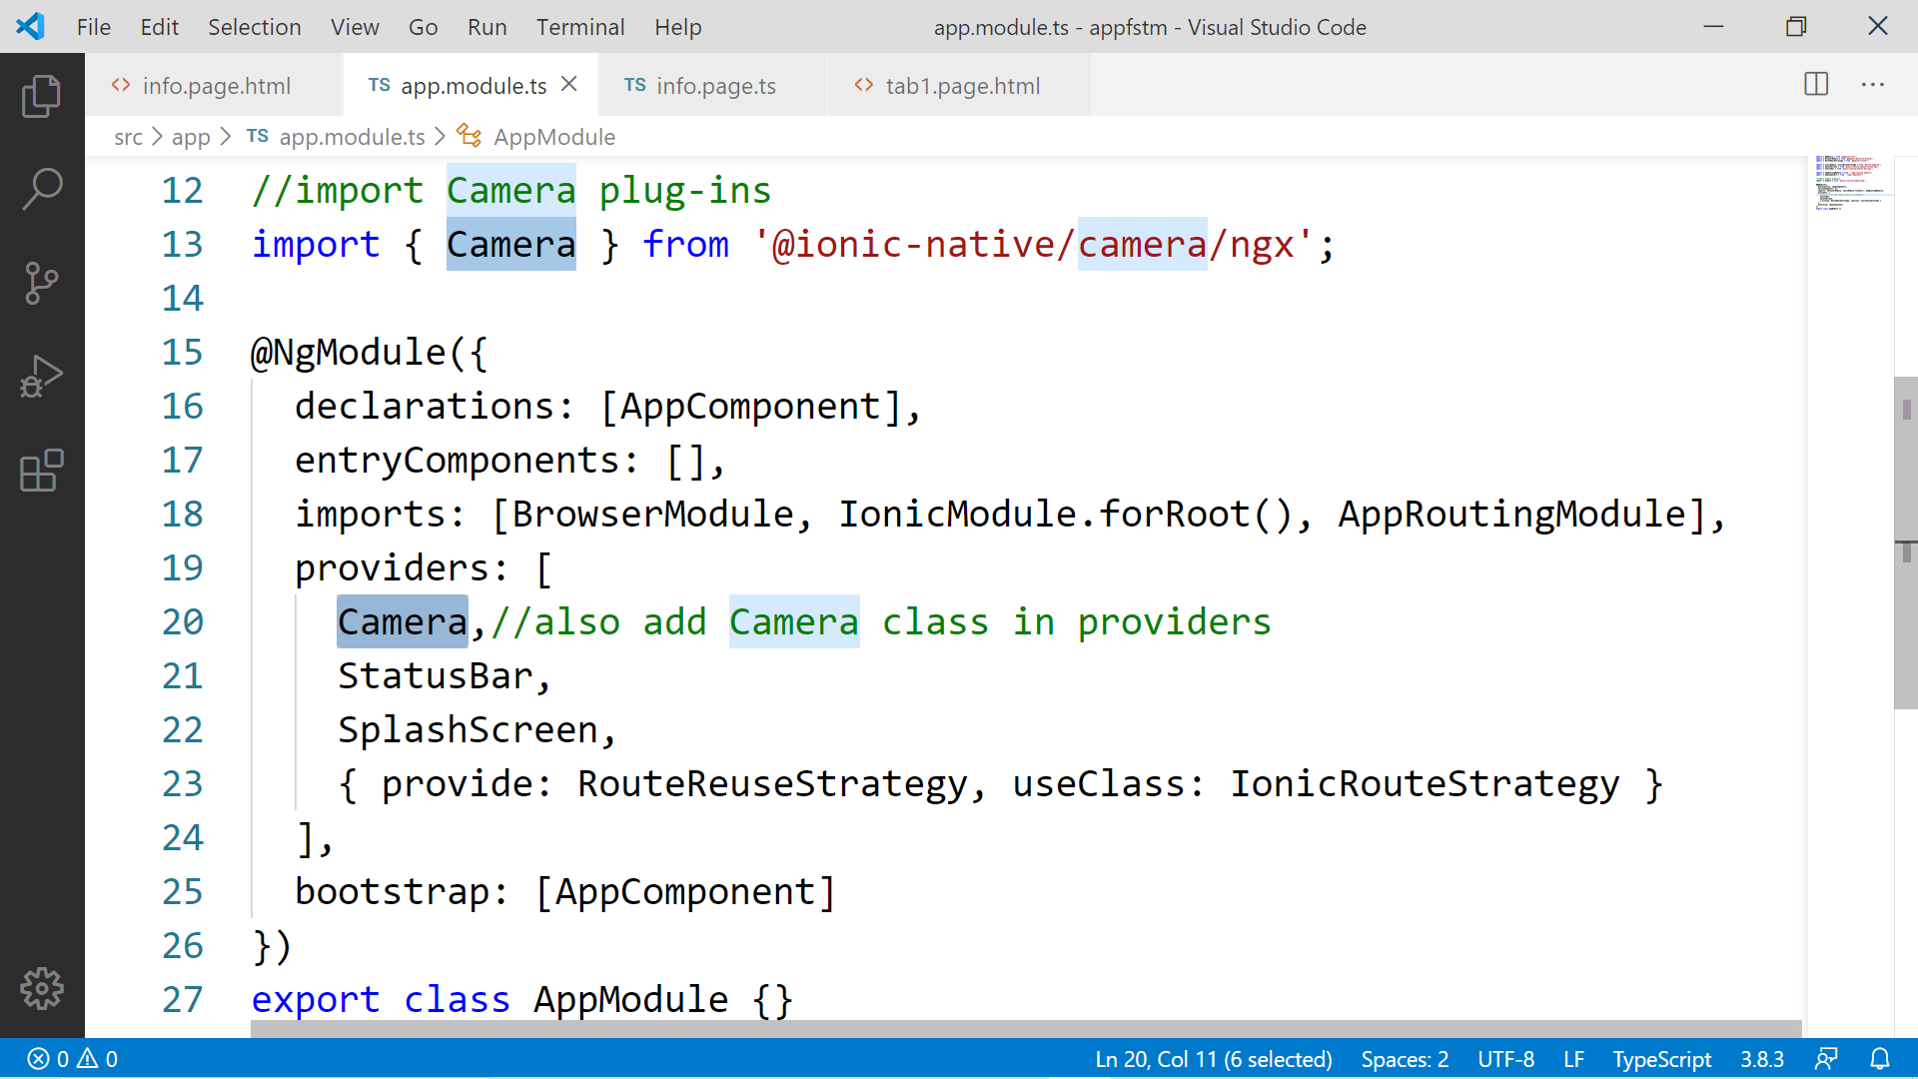

Slide 69
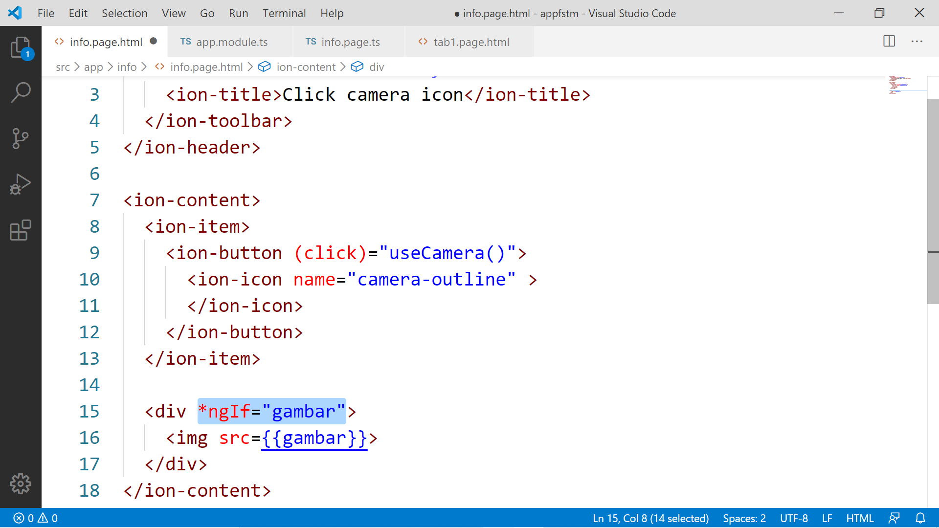

Slide 70
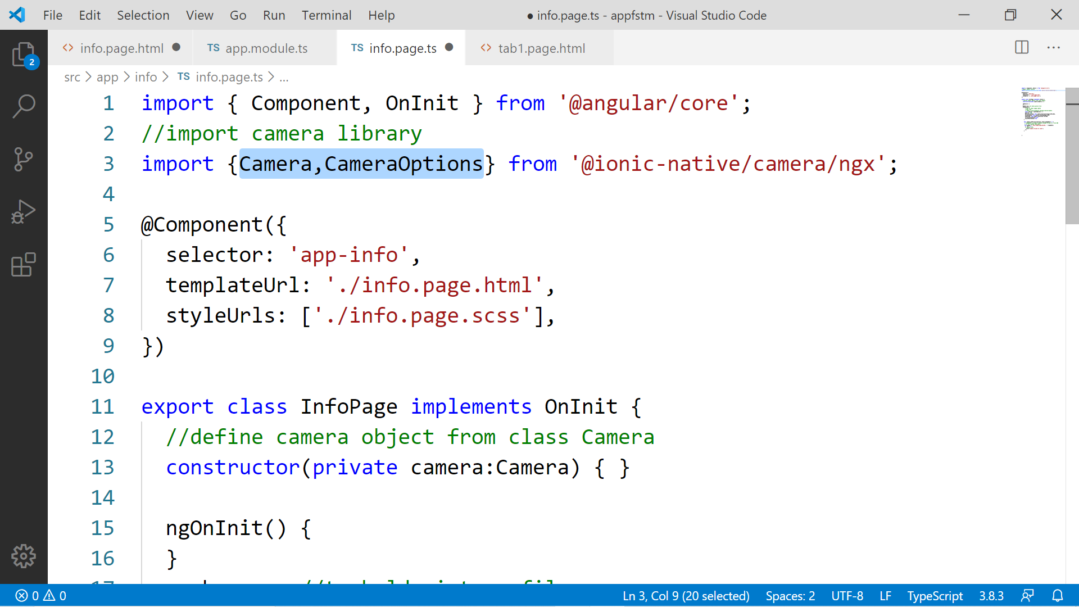

Slide 71
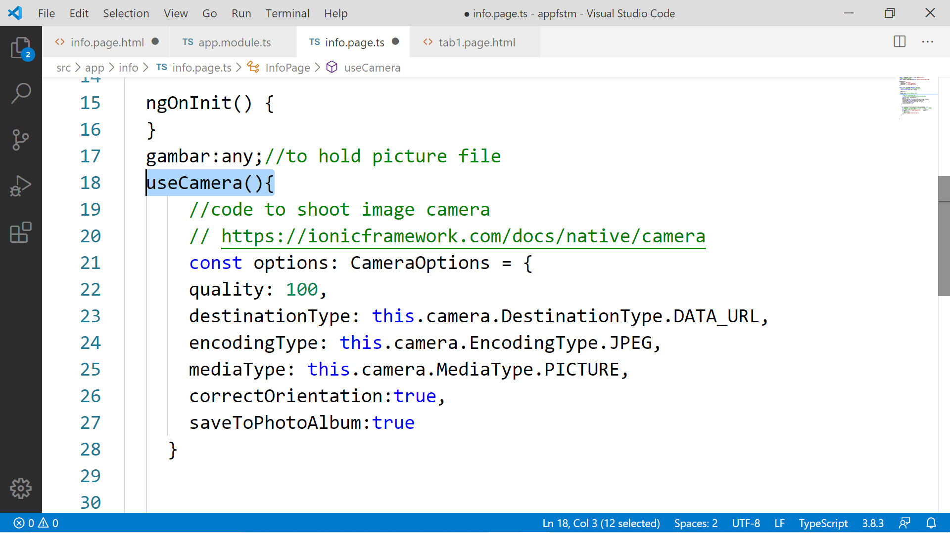

Slide 72
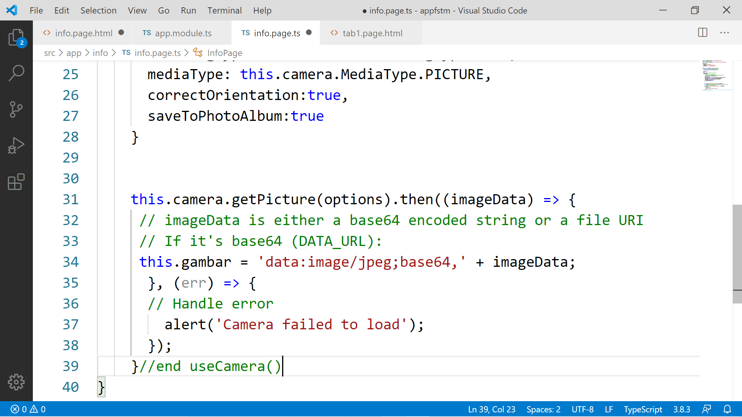

Slide 73
Migration Cordova to Capacitor - error: package android.support.v4.content does not exist
npm install jetifier
npx jetifier
npx cap sync android

Slide 74
Ionic Capacitor
https://ionicframework.com/resources/articles/capacitor-vs-cordova-modern-hybrid-app-development
runs modern Web Apps natively on iOS, Android, Electron, and Web

Slide 75
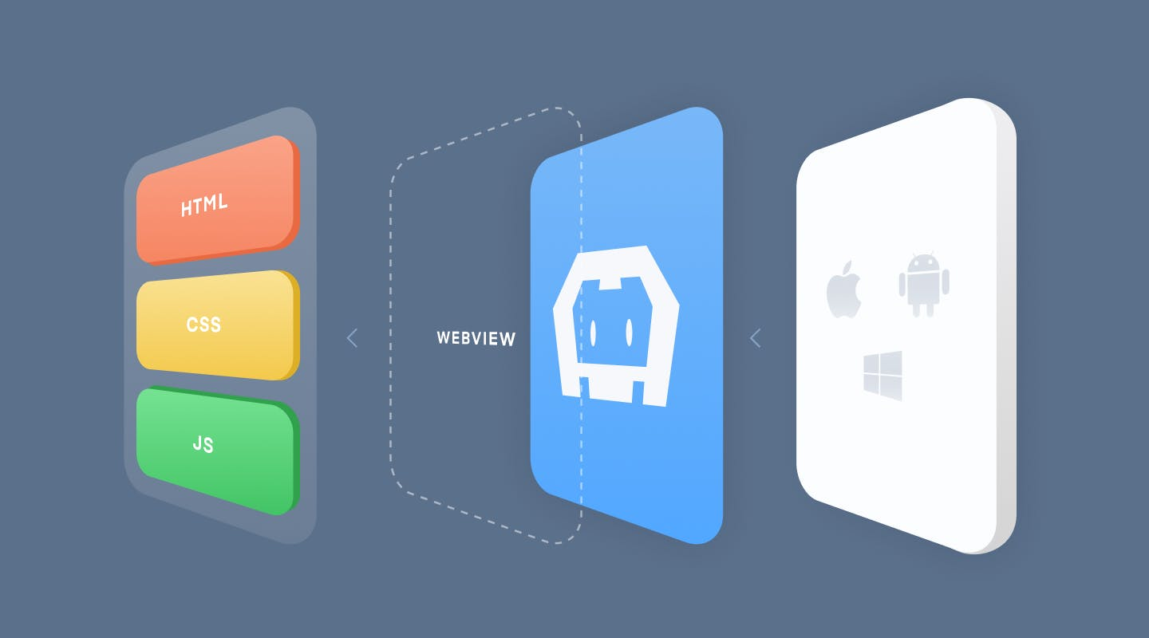
Previously we have CORDOVA

Slide 76
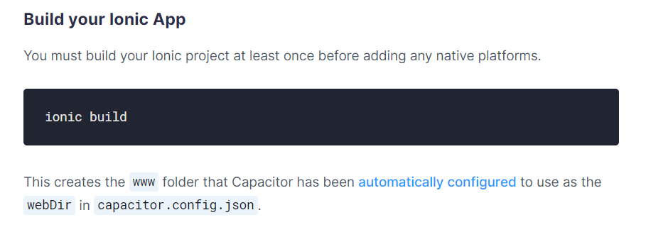
Ionic build

Slide 77
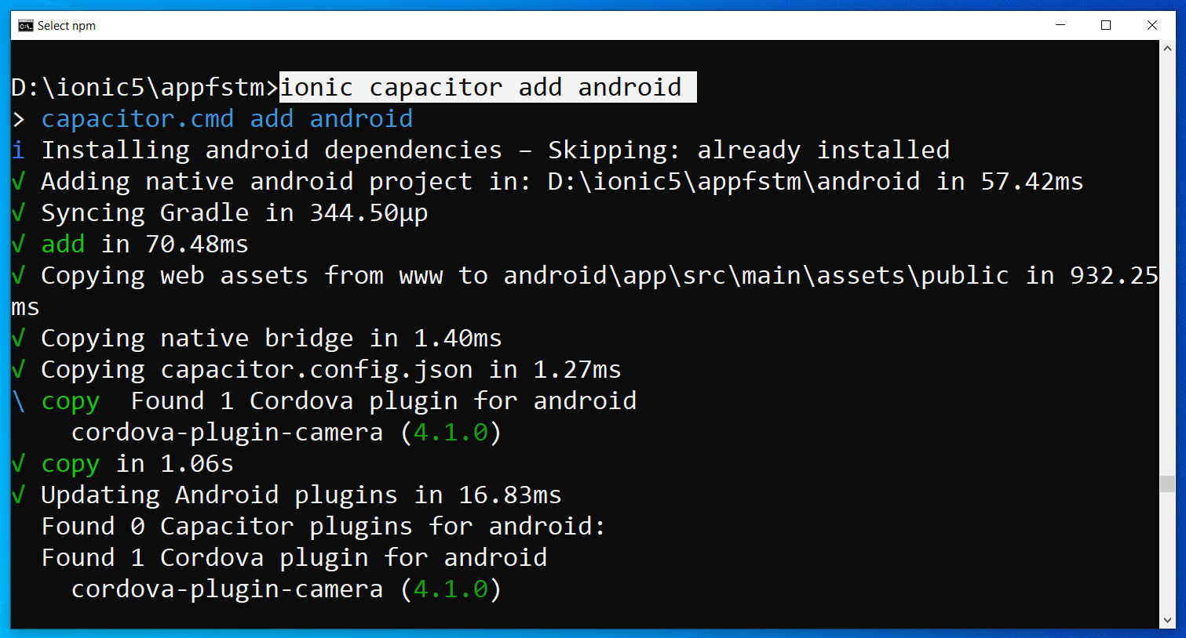
Run only once for each ionic project
To update Android project, execute
ionic build
npx cap copy

Slide 78
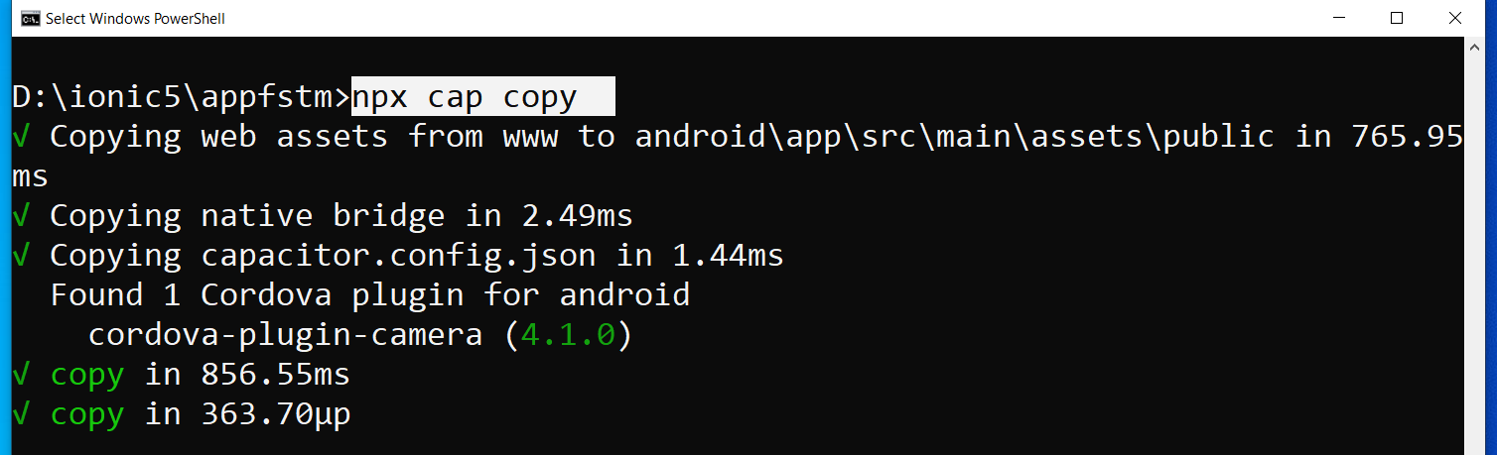
After finish installing the camera plug-ins

Slide 79
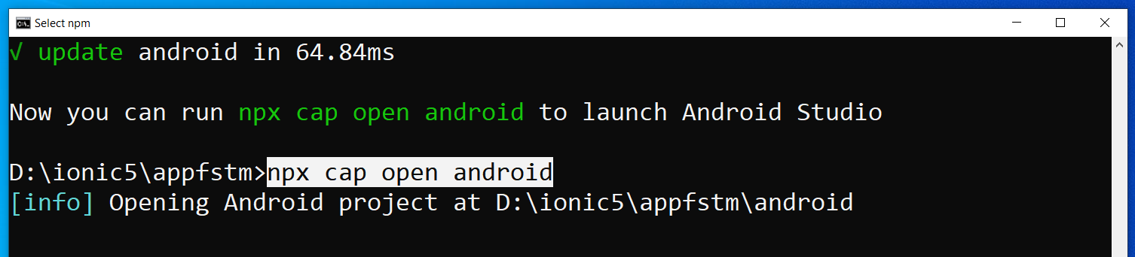
To open project on Android Studio

Slide 80
Codes & slides github.com/khirulnizam/ionic5

Slide 81
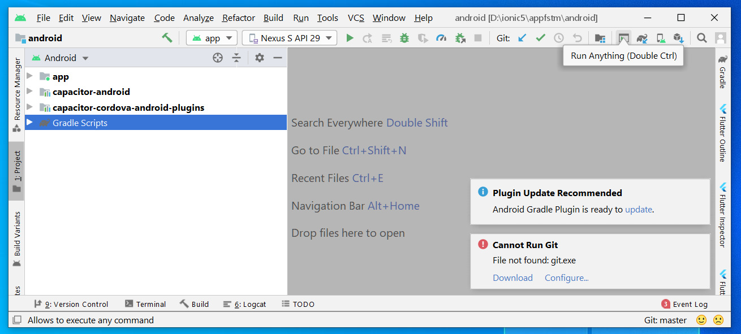
Open in Android Studio

Slide 82
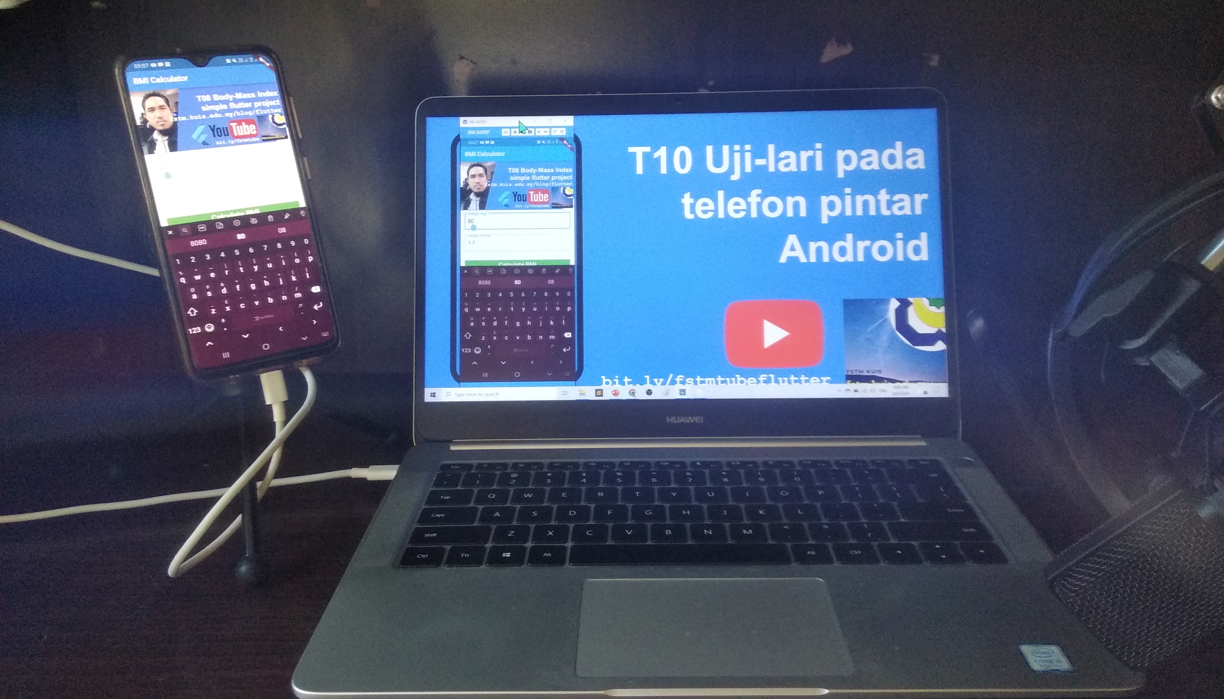


Uji-lari
apps pada
telefon
Android

Slide 83

Android Studio 3.6 & SDK developer.android.com/studio

Slide 84
Path settings (environment variables)
ANDROID_SDK_ROOT
JAVA_HOME

Slide 85
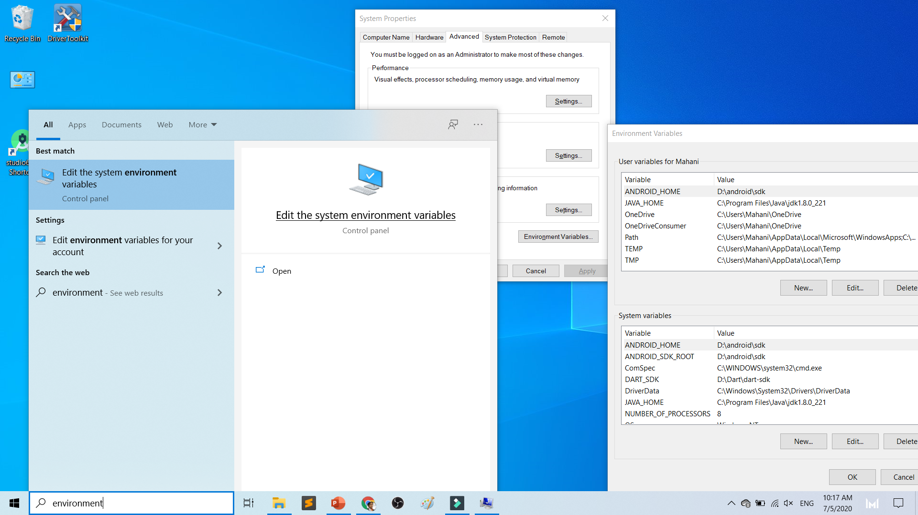

Slide 86
To deploy
Android Studio
Android SDK
Android Phone with USB Debugging enabled
ADB Bridge
USB Data-cable for Actual Device

Slide 87
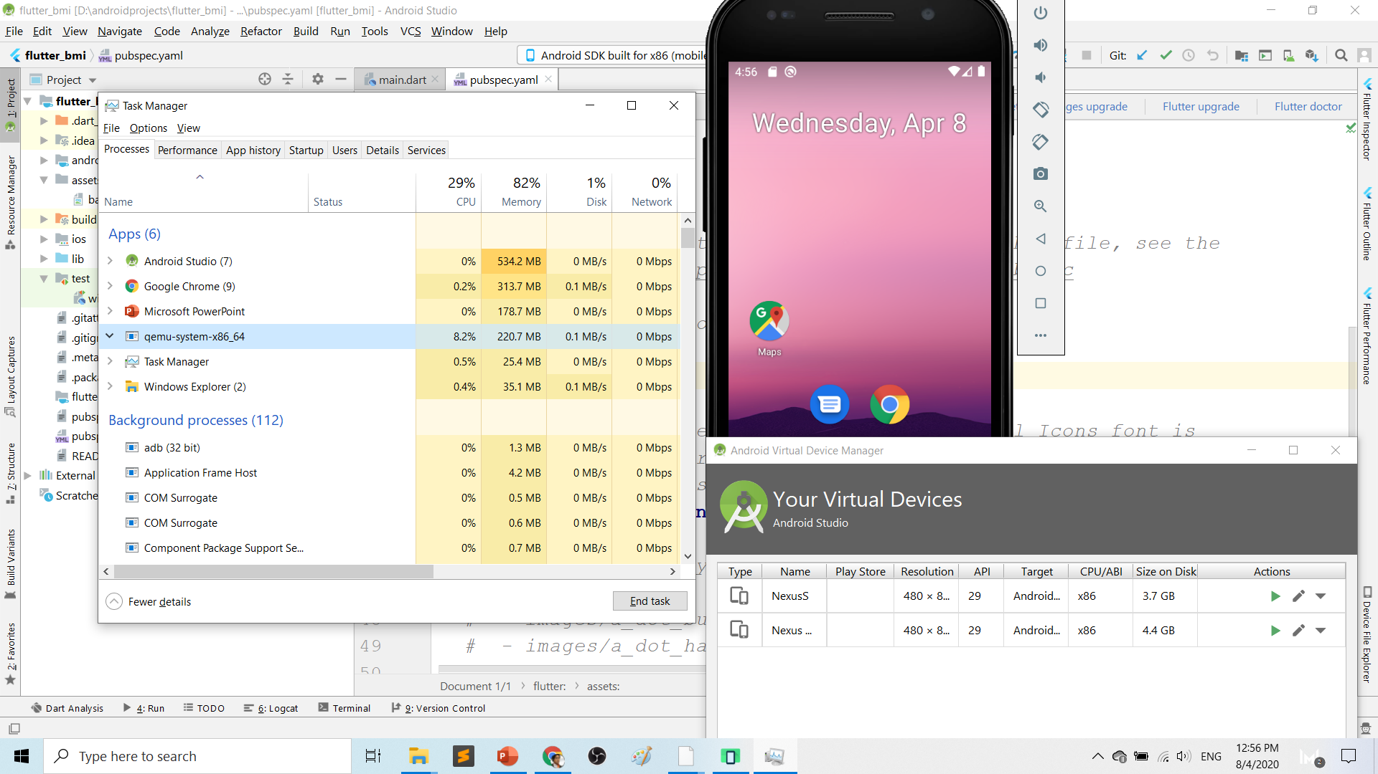
Play.google.com
What’s wrong with Android Studio & Emulator? RESOURCE-HUNGER

Slide 88
Requirements 1. USB debugging ON- phone 2. Connect USB Cable 3. Install ADB driver in PC

Slide 89
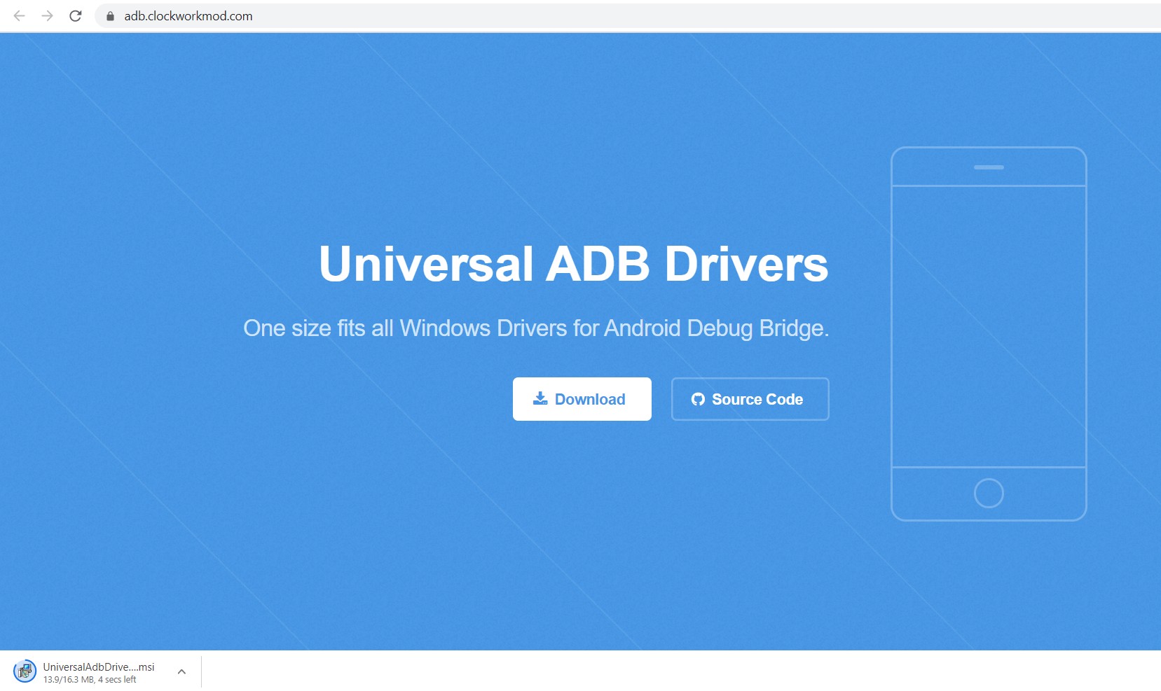
Play.google.com
Install universal debug driver
https://adb.clockworkmod.com/
Download & install universal debug

Slide 90
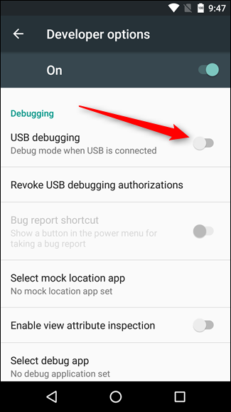
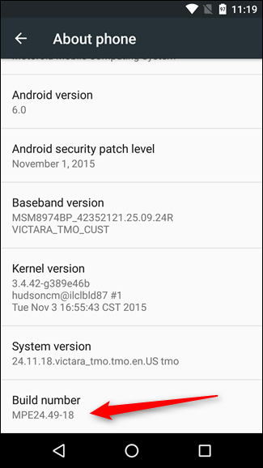
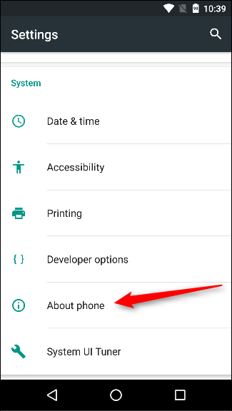
First time to on USB Debugging?
Developer options enable
Press 7X on build number
press 7x

Slide 91
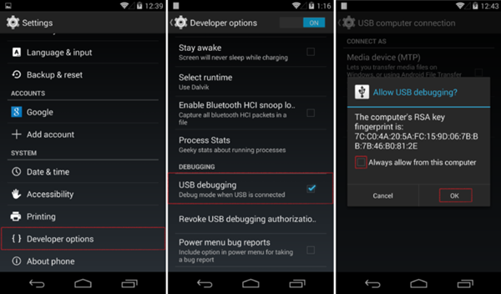
First time Allow USB debugging?

Slide 92
Ionic build

Slide 93
Create Android project/platform ionic capacitor add android
Run only once for each ionic project
To update Android project, execute
ionic build
npx cap copy

Slide 94
Copy to www to android project npx cap copy

Slide 95
To open project on Android Studio npx cap open android

Slide 96
Open in Android Studio

Slide 97
Codes & slides github.com/khirulnizam/ionic5

Slide 98


T07 Pilihan Selection : if…else, ngIf
Codes & slides
github.com/khirulnizam/ionic5

Slide 99
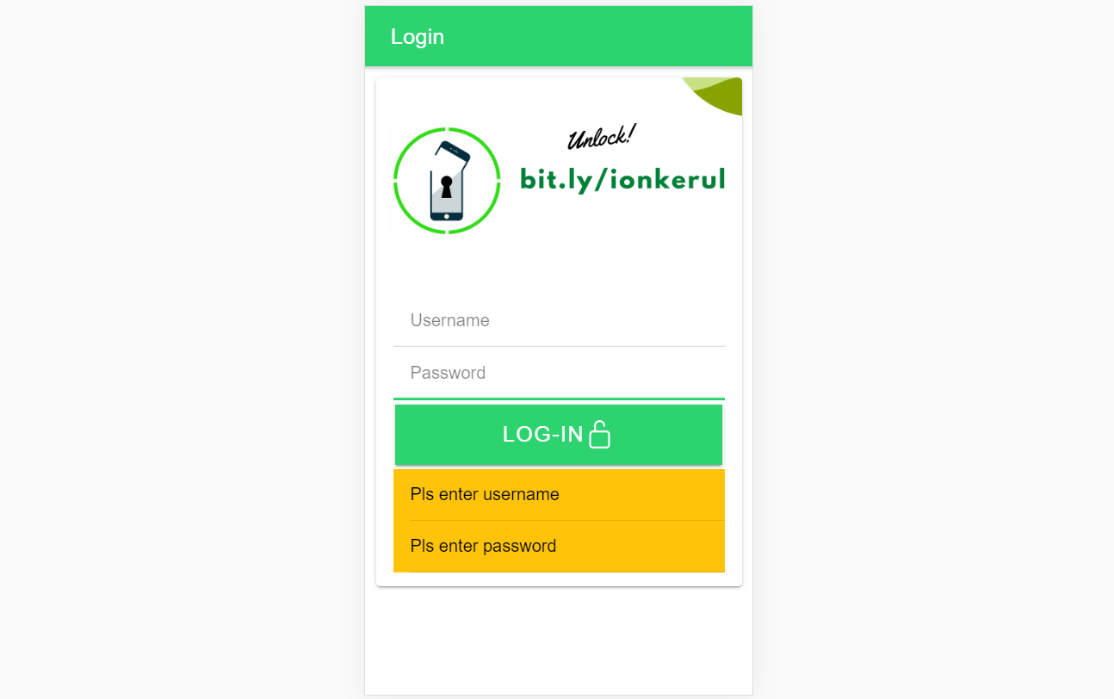
Output overview

Slide 100
Create a new page
ionic g page login
(selection exercise)

Slide 101
[(ngModel)]
Example:
IN TYPESCRIPT:
username:any;
password:any;
IN HTML:
<ion-input [(ngModel)]= “username”>
</ion-input>
<ion-input [(ngModel)]= “password”>
</ion-input>
[(ngModel)] USED IN HTML to capture what is typed into input to TypeScript

Slide 102
*ngIf used in HTML
Usually used for array iterations
Example:
IN HTML
<div *ngIf= “ username==null ”>
Pls enter username
</div>
<div *ngIf= “ password==null ”>
Pls enter password
</div>
*ngIf USED IN HTML

Slide 103
*ngIf … else used in HTML
<div *ngIf="gambar; else noImageYet">
<img src="{{gambar}}">
</div>
<ng-template #noImageYet>
<img src="./assets/noimagep.png">
</ng-template>
*ngIf … else USED IN HTML

Slide 104
IF...ELSE IF...ELSE AND *ngIFStatements
Usually used for selection and/or filtering
Example:
if(username== null){
alert(“Pls insert username”);
}
else if(password==null){
alert(“Pls insert password”);
}
else {
alert(“Welcome user”);
}
IF...ELSE IF..ELSE USED IN TYPESCRIPT IS EXACTLY THE SAME AS JAVASCRIPT

Slide 105
Output

Slide 106

T08 Ulangan Repetition : for, foreach, ngFor

Slide 107
Codes & slides github.com/khirulnizam/ionic5

Slide 108
Create a new page
ionic g page irepeat
(repetition exercise)

Slide 109
For Loop and *ngFor
Usually used for array iterations. Example:
negeri[0]= “Johor”;
negeri[1]= “Melaka”;
negeri[2]= “N. Sembilan”;
negeri[3]= “Selangor”;
for(var x=0;x<negeri.length;x++)
{
console.log(negeri[x]);
}
This will output in the console all the items in the array
FOR LOOP USED IN TYPESCRIPT

Slide 110
For Loop and *ngFor
Usually used for array iterations
Example:
IN TYPESCRIPT
negeri[0]= “Johor”;
negeri[1]= “Melaka”;
negeri[2]= “N. Sembilan”;
negeri[3]= “Selangor”;
IN HTML
<ion-item *ngFor= “let item of negeri”>
{{ item }}
</ion-item>
This will output all the negeris in HTML
*ngFor LOOP used in HTML

Slide 111

T09 Navigasi (navigation with parameters)

Slide 112
PARAMETERS
PAGE 1
(irepeat)
PAGE 2
(displayparams)
Nama: Kerul
Poskod: 43000
Negeri: Selangor
Nama: Kerul
Poskod: 43000
Negeri: Selangor
Nama: Kerul
Poskod: 43000
Negeri: Selangor

Slide 113
Navigation with Parameters
1. Using Router
TO SEND VALUES (CANNOT SEND OBJECTS)

Slide 114
2. Using Services
Navigation with Parameters
*TO SEND OBJECTS

Slide 115
Using ActivatedRoute
On app-routing.module.ts add param name, example /:id
Add /id when navigating
To get param
import {Router} from ‘@angular/router’
public route:Router
let the_id=this.route.snapshot.params.id

Slide 116
Using Services

Slide 117
USING SERVICES
HOME
SERVICES:
Functions
createUser(email, password)
{
…
}
loginUser(){
…
}
listUsers(){
…
}
DAFTAR
LOGIN
OTHER SERVICES

Slide 118
Using SERVICES
Services can be used globally
Can be used repeatedly
By different pages/other services

Slide 119
Generate a service
ionic g service service/data
Import Service and call from page ts

Slide 120


Slide 122
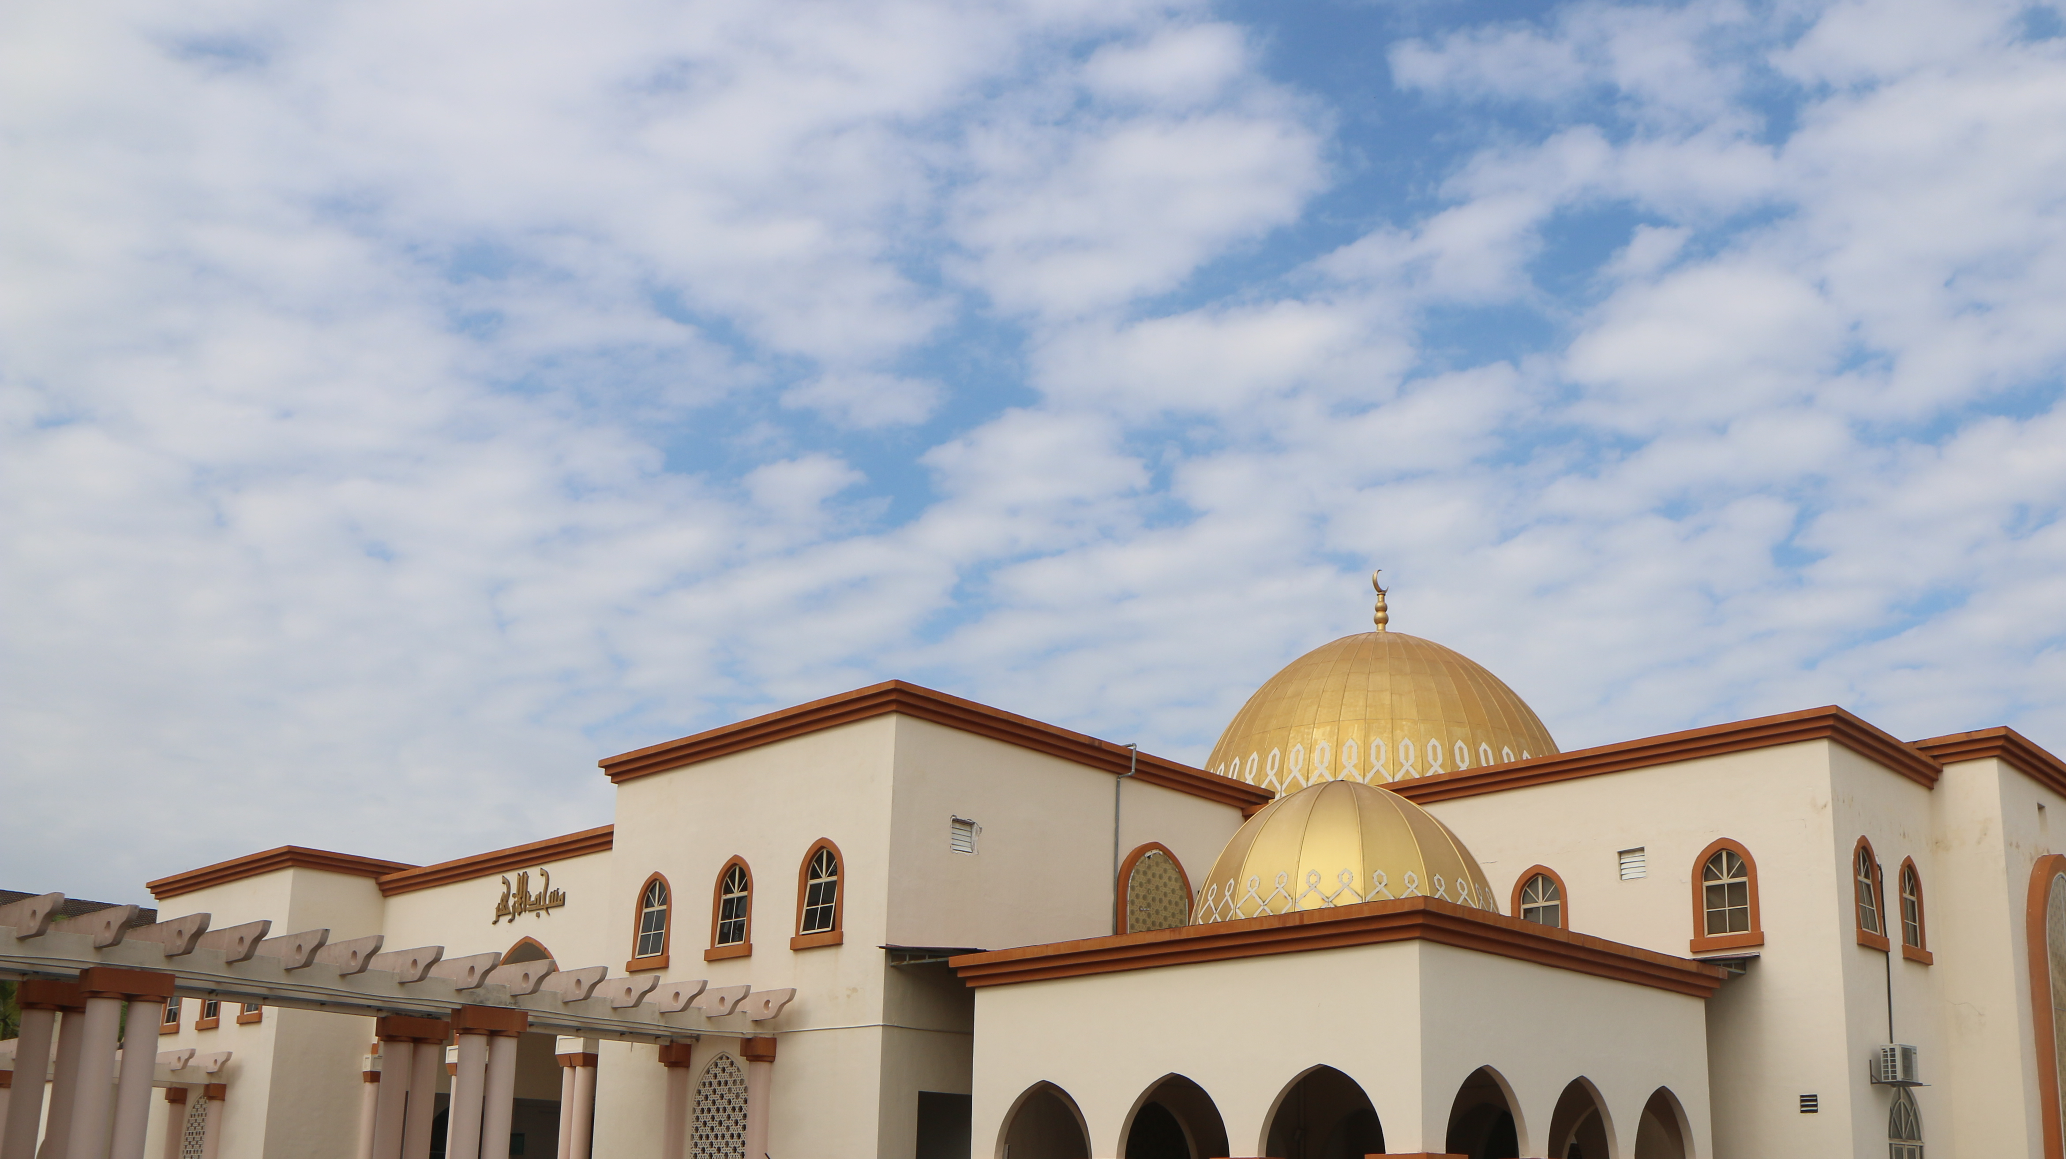

shareMasjid

Slide 123

& Firestore Auth

Slide 124


t10 Firebase (setup)

Slide 125

github.com/khirulnizam/ionic5 wasap.my/60129034614

Slide 126

Serverless option using Firebase
Serverless computing is a method of providing backend services on an as-used basis
A Serverless provider allows users to write and deploy code without the hassle of worrying about the underlying infrastructure
Scalable - the serverless vendor handles all of the scaling on demand
Simplified backend code
Quicker turnaround

Slide 127

JSON Concept
JSON: JavaScript Object Notation.
JSON is a lightweight data-interchange format
JSON format is text only, it can easily be sent to and from a server.

Slide 128
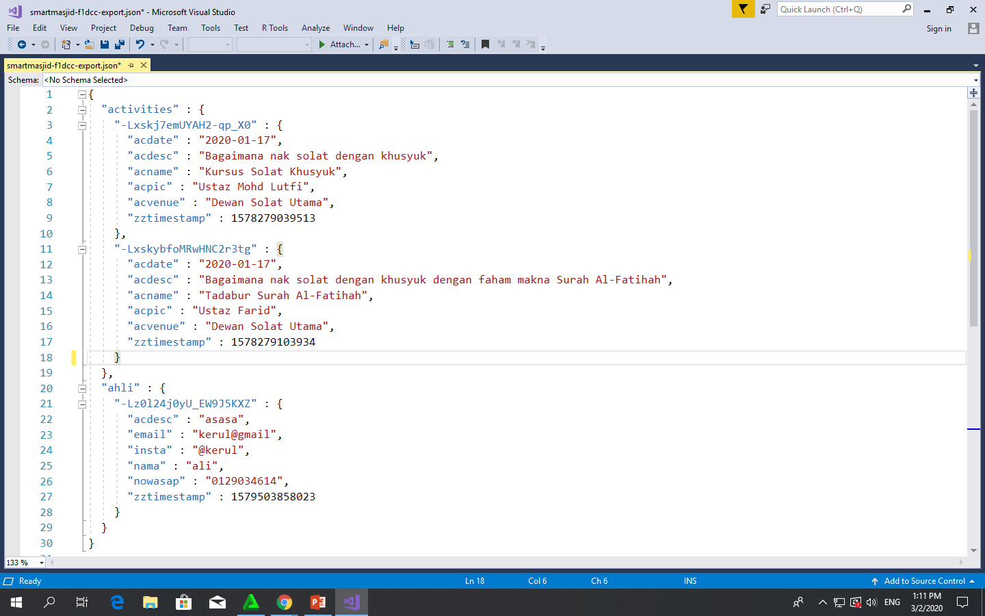
Play.google.com
JSON format example as applied in Firebase

Slide 129
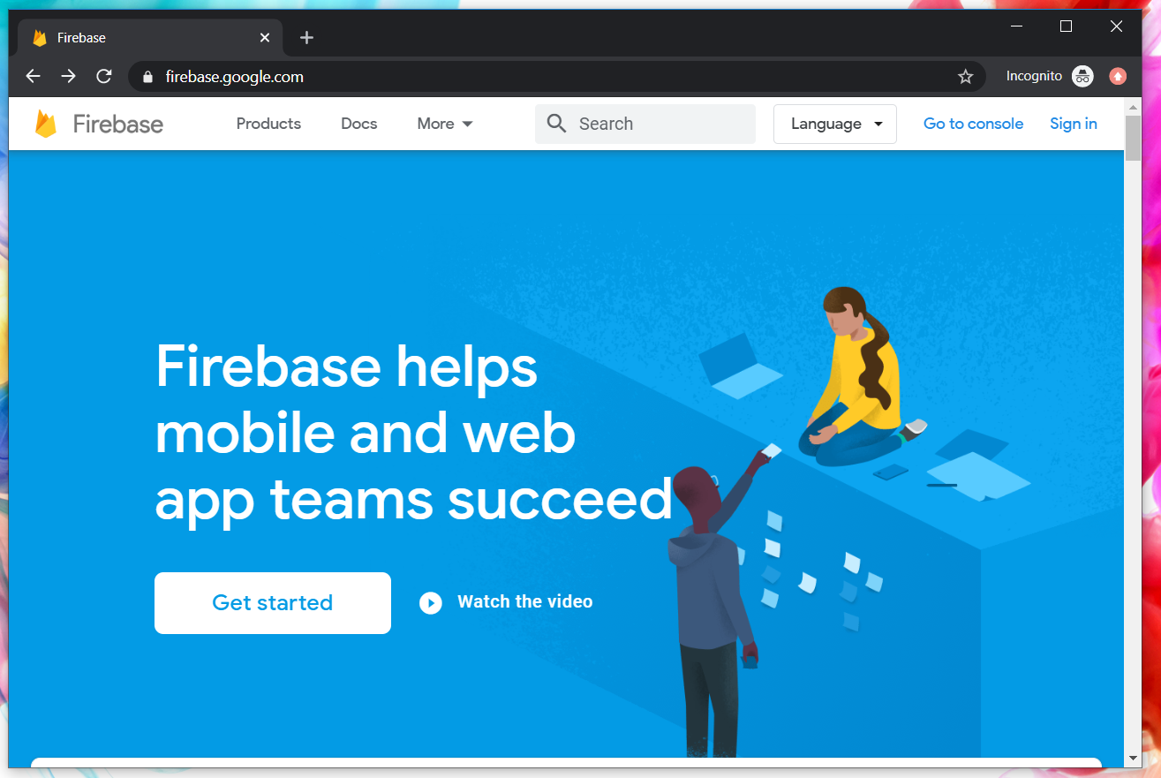
Google Firebase : Console
https://console.firebase.google.com/

Slide 130
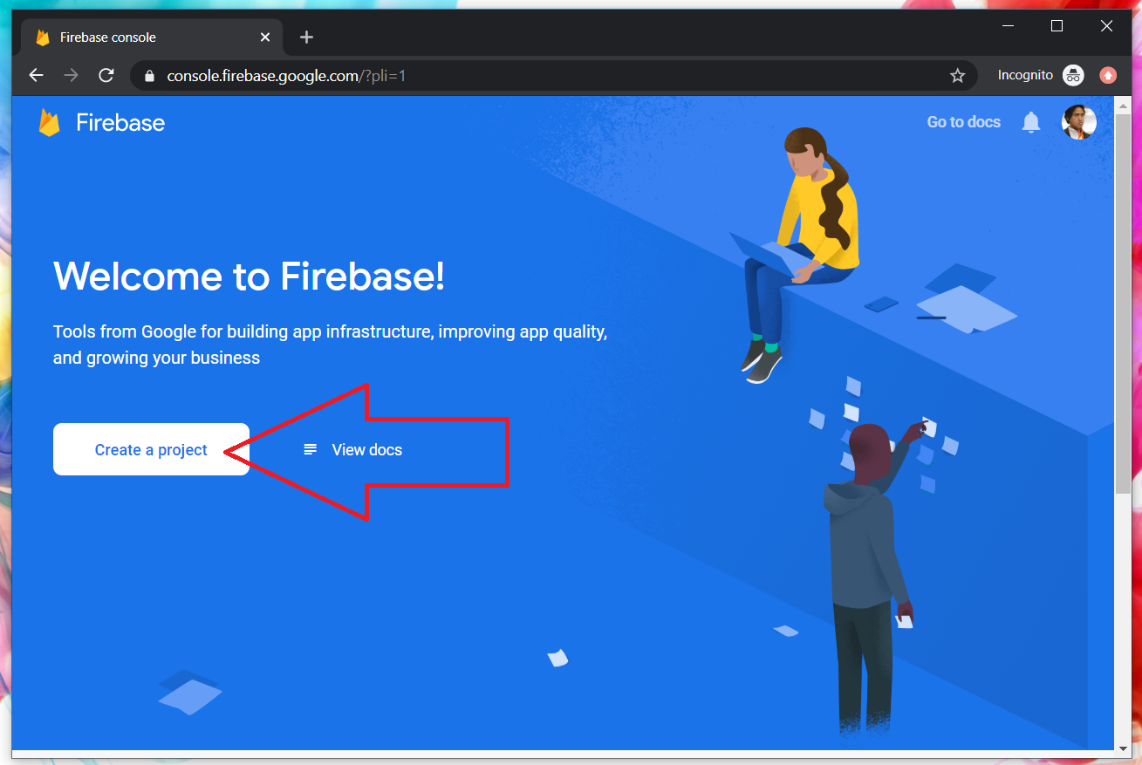
Google Firebase : Create new project

Slide 131
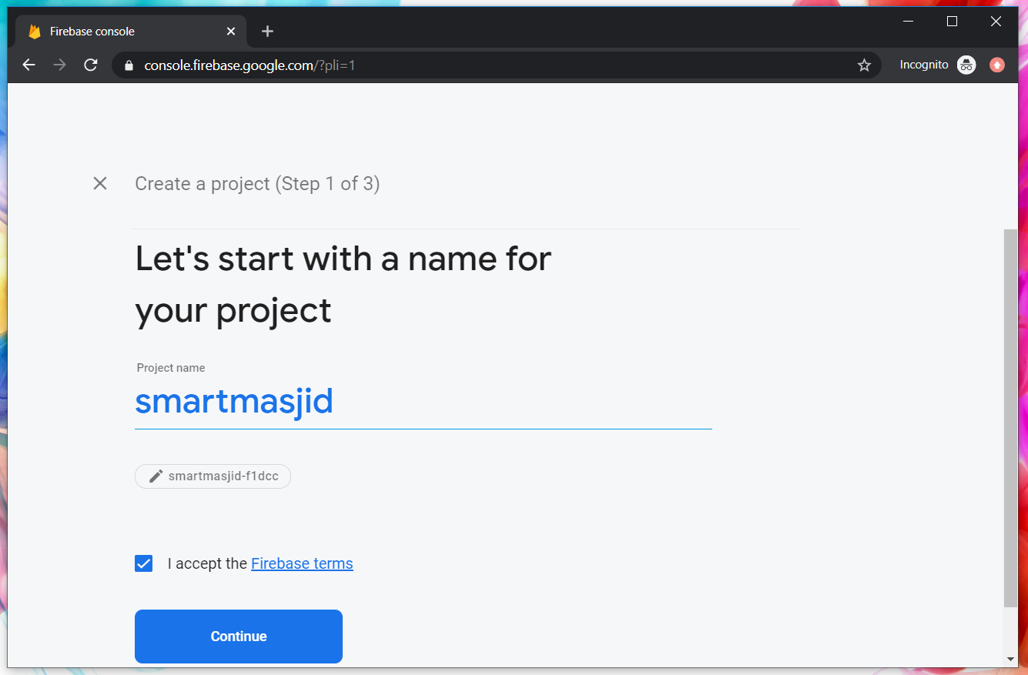
Google Firebase : Project name
sharefstm

Slide 132
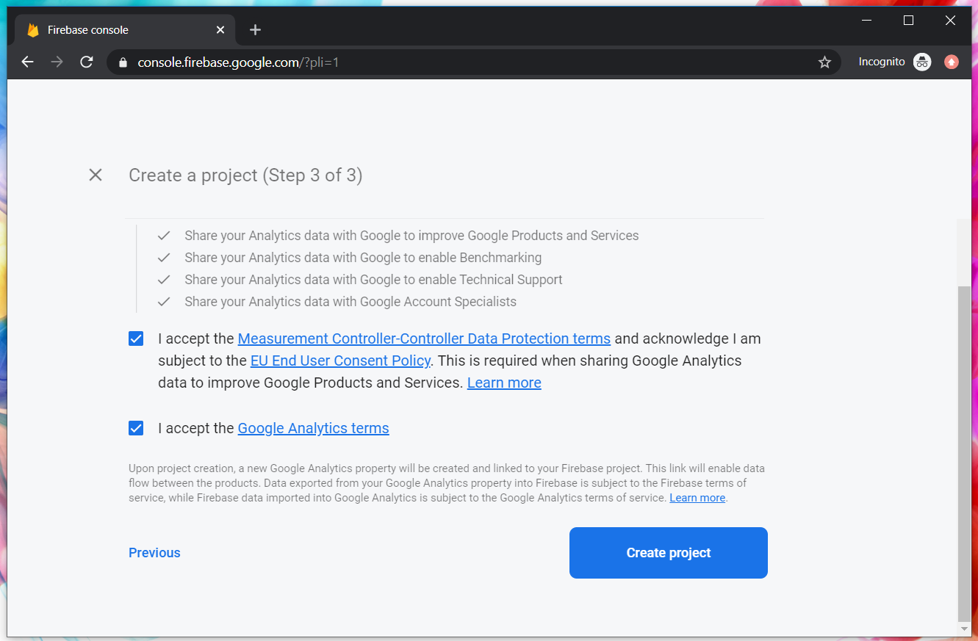
Google Firebase : Accept T&C

Slide 133
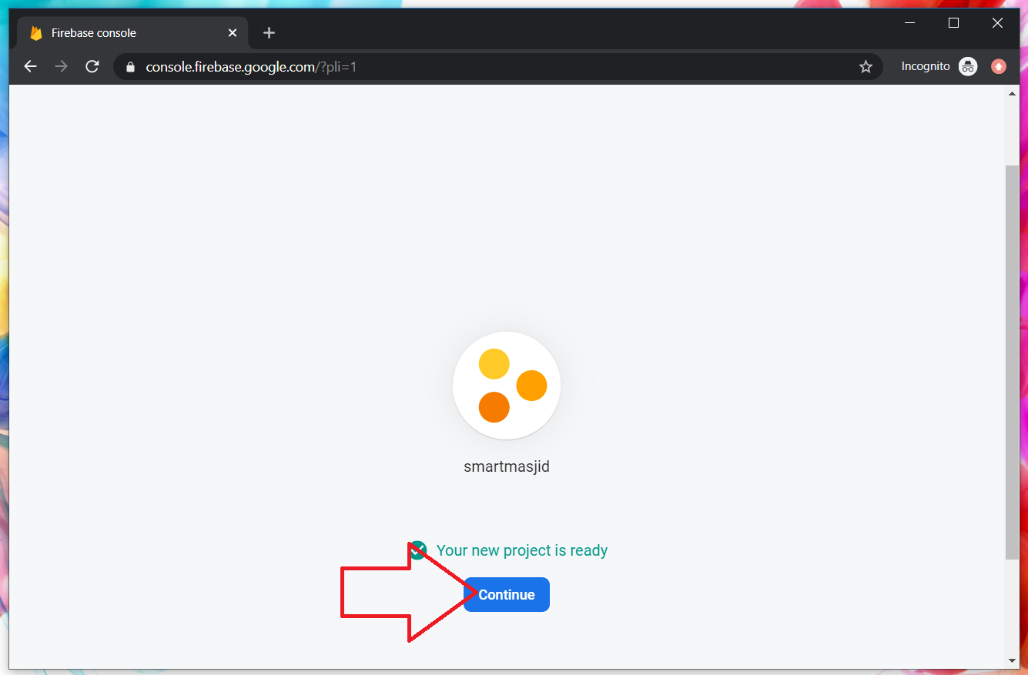
Google Firebase : Project ready and continue
makanapps

Slide 134

Google Firebase : Realtime database, automatic scaling

Slide 135

2
1
3

Slide 136

1
2

Slide 137

Google Firebase : Enable test mode

Slide 138

Google Firestore : add Firebase to app

Slide 139

Web Apps Firebase Configuration : Copy the highlighted

Slide 140

T11 Auth + Register
(daftar pengguna)

Slide 141

Create new Ionic project
ionic start sharefstm blank
Page 1: home

Slide 142

Filename src/app/home/home.page.html

Slide 143
Paste the Firebase configuration to environtment.ts
In environment.ts
…
export const environment : {
production: false,
firebaseConfig: {
apiKey: "AIzXXXXXXXXXXXXXXXWZMPN90HFrp4",
authDomain: "test-projeXXXXXXX.firebaseapp.com",
databaseURL: "https://test-projeXXXXXXX.firebaseio.com",
projectId: "test-projeXXXXXXX7",
storageBucket: "test-projeXXXXXXXX.appspot.com",
messagingSenderId: "446XXXXXX105"
}
};
…

Slide 144
Install AngularFirebase plugins
npm install firebase @angular/fire --save

Slide 145
Filename src/app/app.module.ts
//src/app/app.module.ts
…
//firebase & auth
import { AngularFireModule } from '@angular/fire';
import { AngularFireAuthModule } from '@angular/fire/auth';
import { environment } from '../environments/environment';
…
imports: [BrowserModule, IonicModule.forRoot(), AppRoutingModule,
//firebase & auth
AngularFireAuthModule,
AngularFireModule.initializeApp(environment.firebaseConfig),
…

Slide 146
Create globally accessible functions in folder services
ionic g service services/firebase
import { AngularFireAuth } from '@angular/fire/auth';
…
export class FirebaseService {
constructor(
private afAuth: AngularFireAuth
) { }
registerUser(email, password) {
return new Promise<any>((resolve, reject) => {
this.afAuth.createUserWithEmailAndPassword(email, password)
.then(
res => resolve(res),
err => reject(err))
})
}

Slide 147

Add another page
ionic g page daftar
Page 2: daftar

Slide 148

Filename src/app/daftar/daftar.page.html

Slide 149

Filename src/app/daftar/daftar.page.html

Slide 150

Filename src/app/daftar/daftar.page.ts

Slide 151

Filename src/app/daftar/daftar.page.ts

Slide 152


Slide 153
T12 Auth + Login
(pengesahan pengguna)

Slide 154
github.com/khirulnizam/ionic5 wasap.my/60129034614

Slide 155
Add globally accessible functions in folder services
ionic g service services/firebase
import { AngularFireAuth } from '@angular/fire/auth';
…
loginUser(email, password) { //function loginUser
return new Promise<any>((resolve, reject) => {
//authenticating with email & password
this.afAuth.signInWithEmailAndPassword(email, password)
.then(
res => resolve(res), //successful
err => reject(err)) //rejected
})
}//end loginUser
…

Slide 156

Add another page
ionic g page login
Page 3: login

Slide 157

Filename src/app/login/login.page.html

Slide 158

Filename src/app/login/login.page.html

Slide 159
Filename src/app/login/login.page.ts
…
cubalogin(email, password) {
this.fService.loginUser(this.email, this.password)
.then(res => {
console.log(res);
this.errorMessage = "";
//this.navCtrl.navigateForward('/dashboard');
}, err => {
this.errorMessage = err.message;
})
}//end cubalogin
…

Slide 160
github.com/khirulnizam/ionic5 wasap.my/60129034614

Slide 161





CRUDS

Slide 162

T13 Rekod Baharu
(insert new record)

Slide 163
github.com/khirulnizam/ionic5 wasap.my/60129034614

Slide 164
T14 Papar Senarai Rekod

Slide 165
github.com/khirulnizam/ionic5 wasap.my/60129034614

Slide 166
T15 Carian

Slide 167
github.com/khirulnizam/ionic5 wasap.my/60129034614

Slide 168
T16 Kemaskini
(update record)

Slide 169
github.com/khirulnizam/ionic5 wasap.my/60129034614

Slide 170
T17 Padam
(delete record)

Slide 171
Ionic5
Online Workshop
12&13 Nov 2020
9am-12noon
Google Meet

Slide 172

Pengujian apps pada Android Emulator

Slide 173

Download Android Studio https://developer.android.com/studio

Slide 174

File -> New -> New Project

Slide 175

Package name

Slide 176

Tools -> AVD Manager

Slide 177

+ Create Virtual Device

Slide 178

Minimal resolution device

Slide 179

Choose available Android system image

Slide 180

If system image not yet available
Download Android
system image for
1.5GB! (estimation)

Slide 181

AVD name
Click Finish

Slide 182

Run Android Virtual Device

Slide 183

Run
Shift+F10

Slide 184

Apps is
Running
On AVD

Slide 185
Slides & materials github.com/khirulnizam/ionic5

Slide 186


Muatnaik Apps ke
Google Playstore
Fblive FSTM KUIS
11pg 6Nov 2020 (Jumaat)

Slide 187

←App ID

Slide 188

Play.google.com
Register for a developer ID
USD25 for life.
Another consideration: you need to pay through Google Wallet, using a credit card. https://play.google.com/apps/publish/

Slide 189
Playstore Graphic Materials
high-res icon. (size 512px x 512px)
Featured graphic. (size 1024px x 500px)
at least 2 non-Android TV screenshots. (2 screenshot images. Min length for any side: 320px)

Slide 190

Samples of graphic materials & signed bundle/APK

Slide 191
Graphic materials github.com/khirulnizam/ionic5

Slide 192



Slide 193


Icon
launcher
& Splash
screen

Slide 194
https://ionicframework.com/docs/cli/commands/cordova-resources
Graphic materials
resources/icon.png (with size 1024x1024)
resources/splash.png (with size 2732x2732)

Slide 195

https://ionicframework.com/docs/cli/commands/cordova-resources
Graphic materials
resources/icon.png (with size 1024x1024)
resources/splash.png (with size 2732x2732)
(create folder resources)
splash.png
(2732x2732px)
icon.png (1024x1024px)

Slide 196
https://ionicframework.com/docs/cli/commands/cordova-resources
Commands - CLI
ionic cordova resources

Slide 197

Ionic cordova resources
(created after ionic cordova resources)

Slide 198
In file package.json add
"scripts": {
…
"resources":"cordova-res --skip-config --copy",
…
}

Slide 199
Build, copy and open in Android Studioclz
ionic capacitor add android (sekiranya belum)
ionic build
npx cap sync android
npm install capacitor-resources -g
cordova-res --skip-config --copy
npx cap open android
Run apps in Android Studio
cordova-res to copy icon/splash from resources to Android project res folder

Slide 200


Ionic vs Flutter

